Slide 1
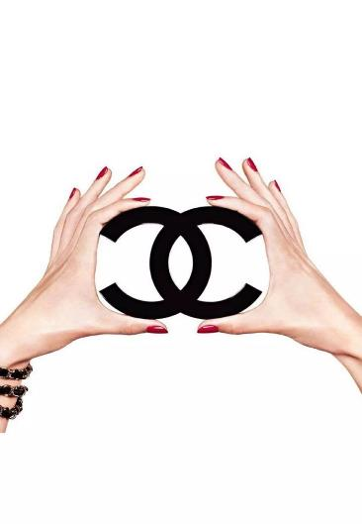
TD Marketing Opérationnel
Professor: Mr.CHHEAV Narath
Group Members:
-NITH Kosal
-MEAS Sreita
-YEA Mey Mey
-VON Sreykeo
-MUTH Sumontheany
-SENG Sina
Price
CHANEL

Slide 2
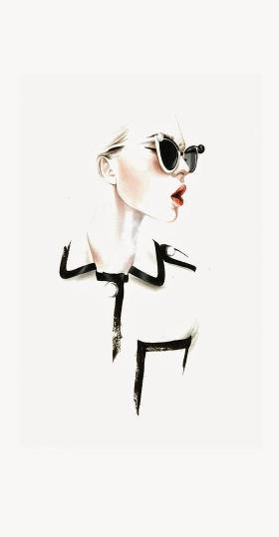
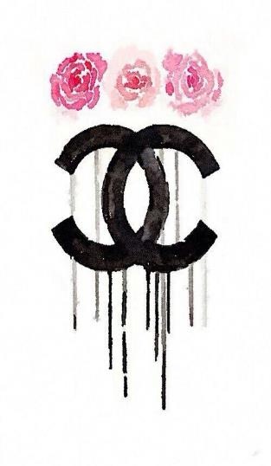
CONTENTS
Introduction
1.1 History
1.2 Products Range
2. CHANEL’s Price Strategy
2.1 Haute Couture
2.2 Make-Up & Skin Care
2.3 Jewelry
2.4 Fashion (Prêt-à-Porter)
2.5 Fragrance (Perfumes)
3. Conclusion

Slide 3
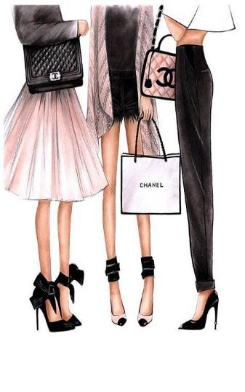
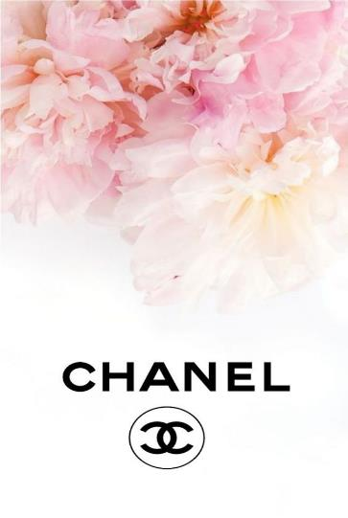
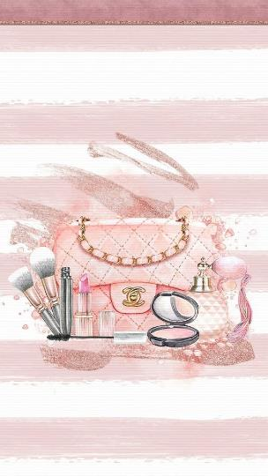
1. Introduction

Slide 4
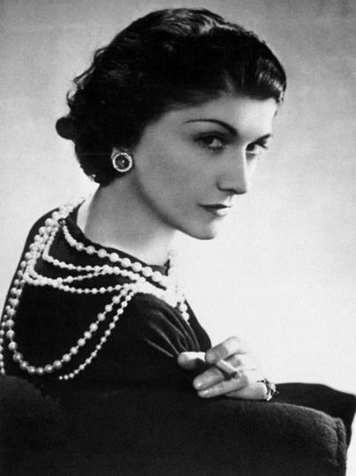
1.1 History
Chanel S.A. is a French privately held company owned by Alain Wertheimer and Gérard Wertheimer, grandsons of Pierre Wertheimer, who was an early business partner of the couturière Gabrielle Bonheur Chanel.
Industry: Fashion
Founded: 1909 (110 years ago)
Founder: Ms. Gabrielle Bonheur Chanel (also called Coco Chanel)
Revenue: Increase $ 9.6 billion (2017)
Net income: € 1.3 billion(2016)
Number of employees: 20,000 (2018)
“EMPOWERED WOMEN CHANGE THE WORLD”

Slide 5
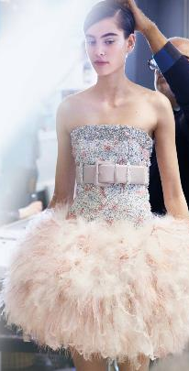
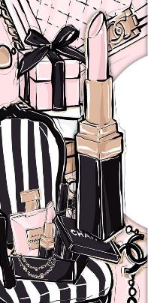
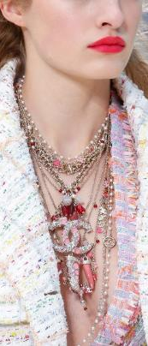
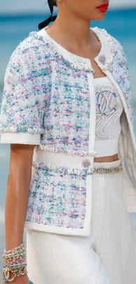
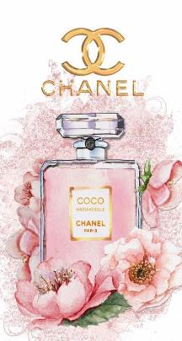
1.2 Product Range
Make-Up & Skin Care
Haute couture
Jewelry
Ready-to-Wear
Perfumes

Slide 6
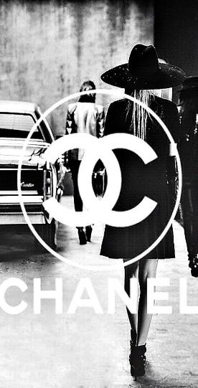
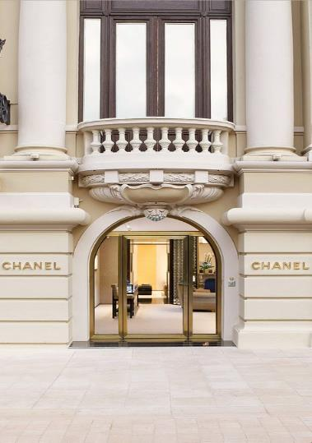
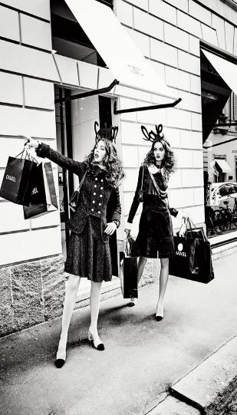
2. CHANEL’S Price Strategy

Slide 7
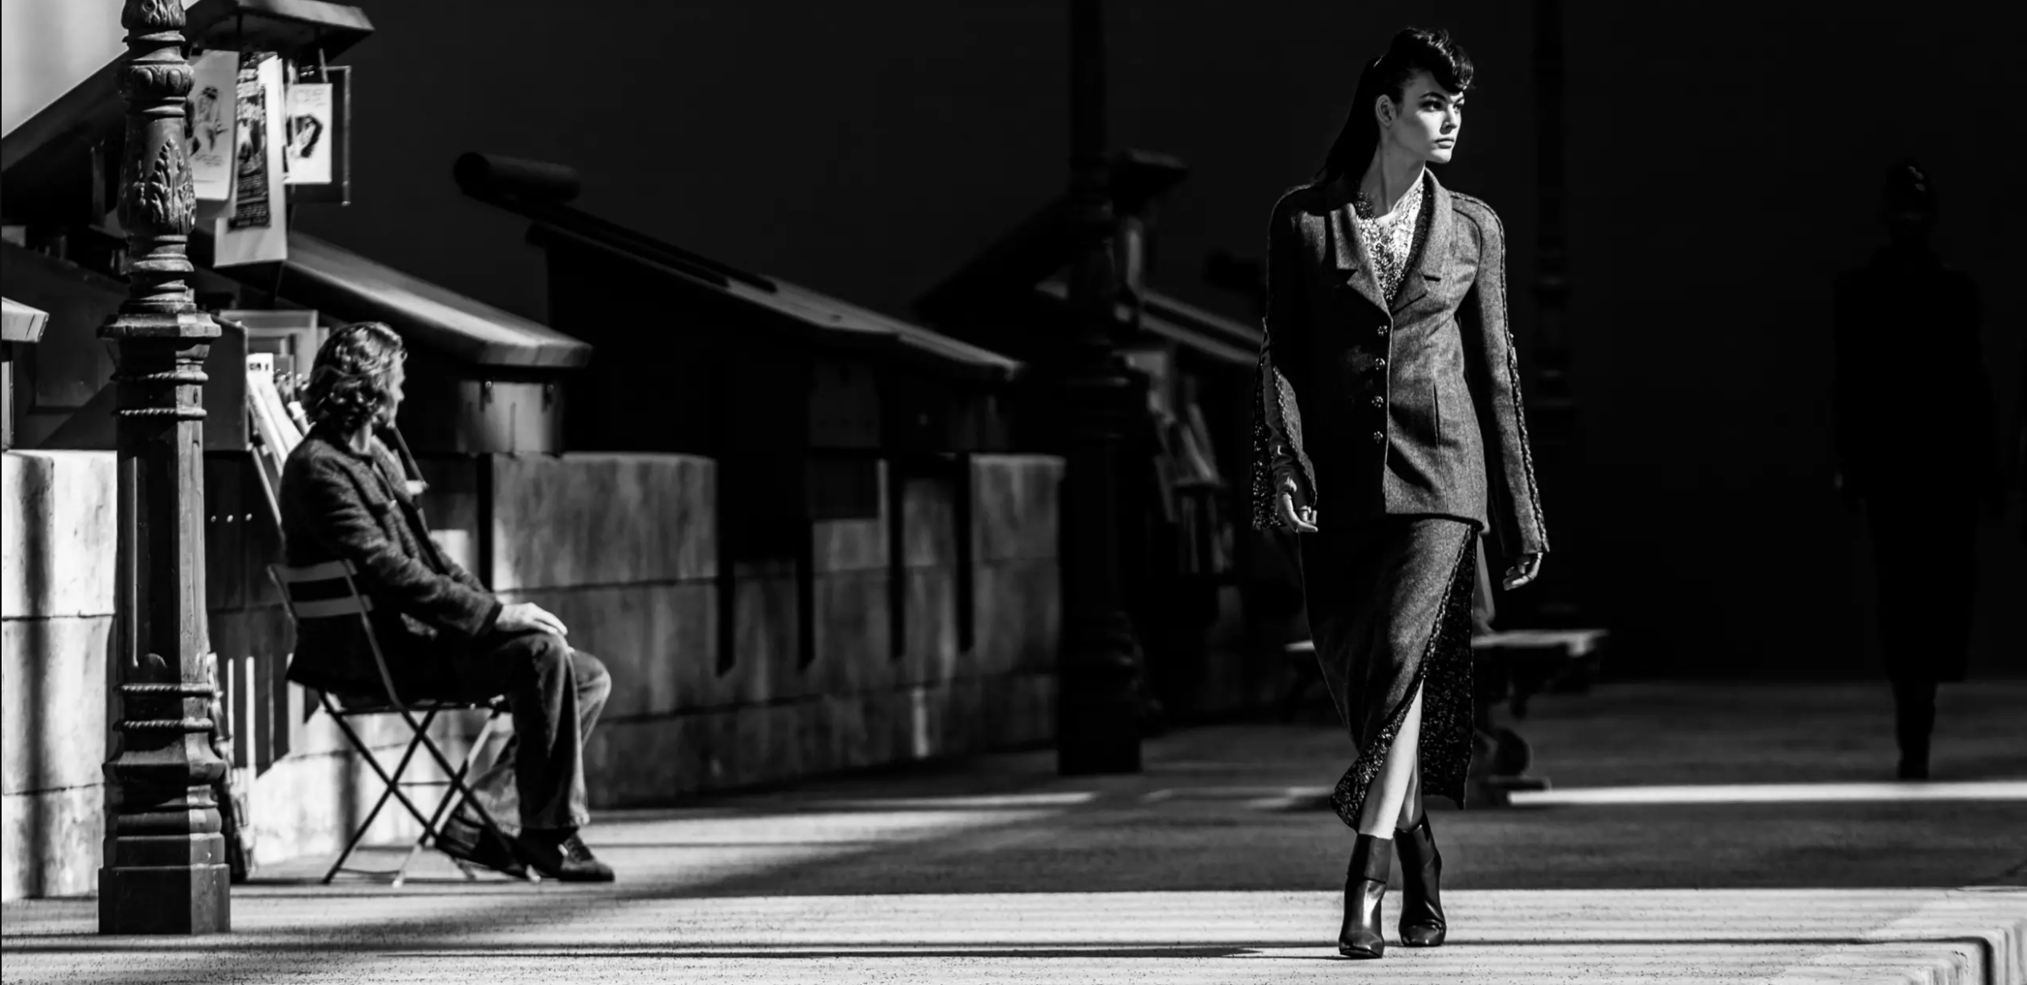
2.1 Haute Couture
Haute Couture or “High Fashion”
Gabrielle Chanel first opened her Couture house in 1915
The price of Chanel’s Haute Couture luxury brand must reflect the key messages of any luxury brand: quality, heritage, and exclusivity.
“It is the utmost luxury which transcends fashions and crosses time.” -Karl Lagerfeld

Slide 8
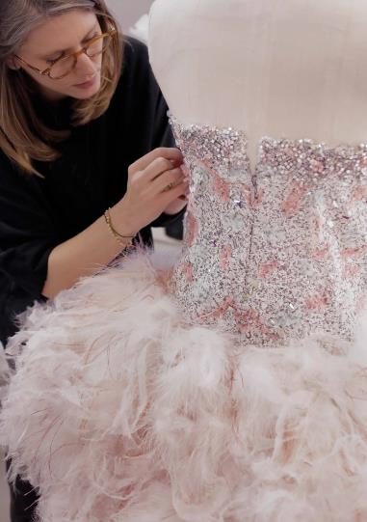
The cost of a couture item can runs from about 10,000$ to 60,000$, with the far end going beyond 100,000$.
A Chanel couture suit for example can cost more than 20,000$ and an evening dress can cost to 50,000$, and beyond.

Slide 9
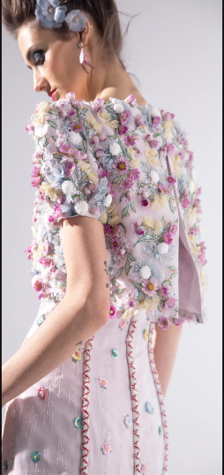
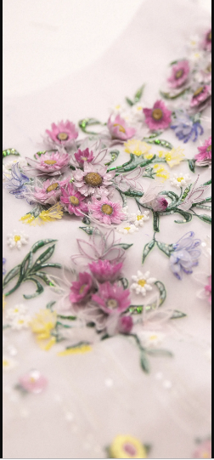
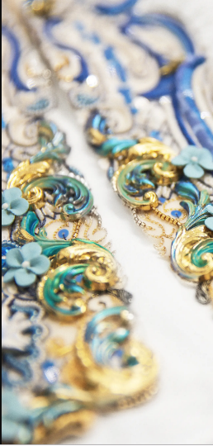
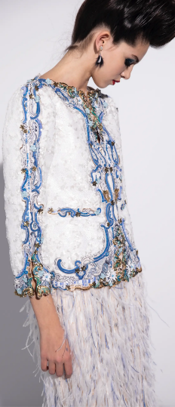

Slide 10
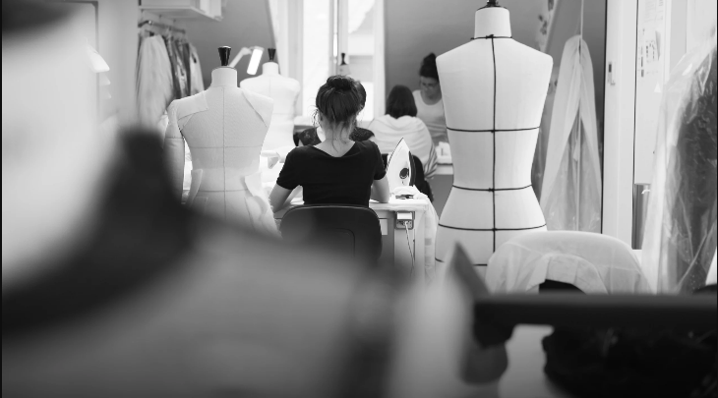
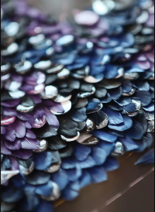
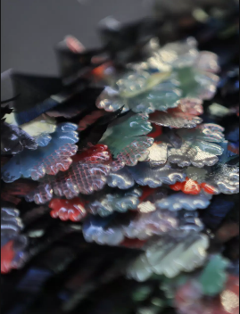
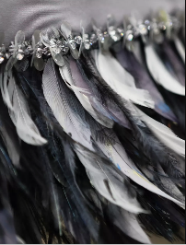
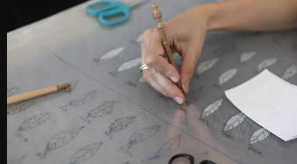
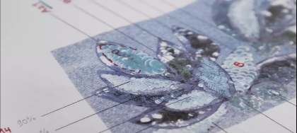

Slide 11
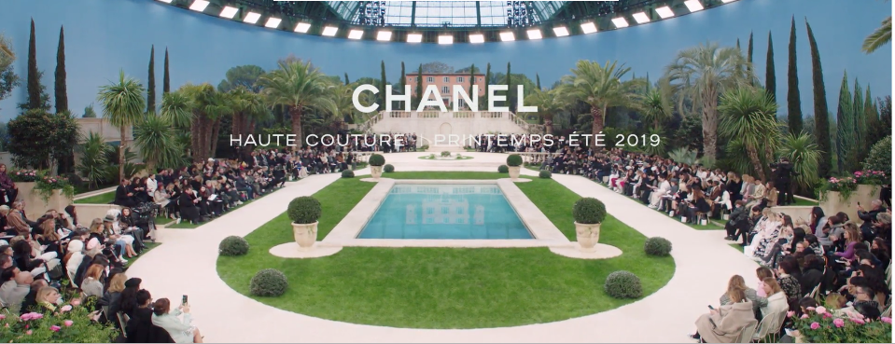
-New designs will be shown at every Paris Haute Couture Fashion weeks, where the rich customers can see pass before their eyes the models wearing the clothes.
-From the time, the first Chanel shop was established, it has been catering to the fashion needs of high-class aristocrats of the society; those able to afford couture are happy to pay for exclusivity and the privacy afforded by the system.

Slide 12
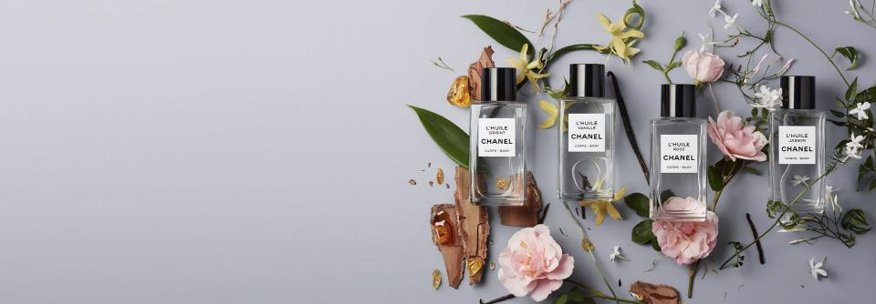
2.2 CHANEL
Beauty Products

Slide 13
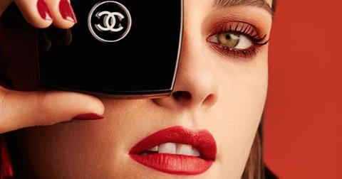
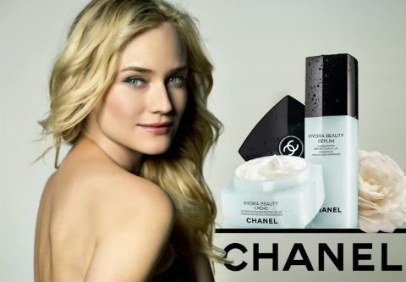
1924
1929

Slide 14
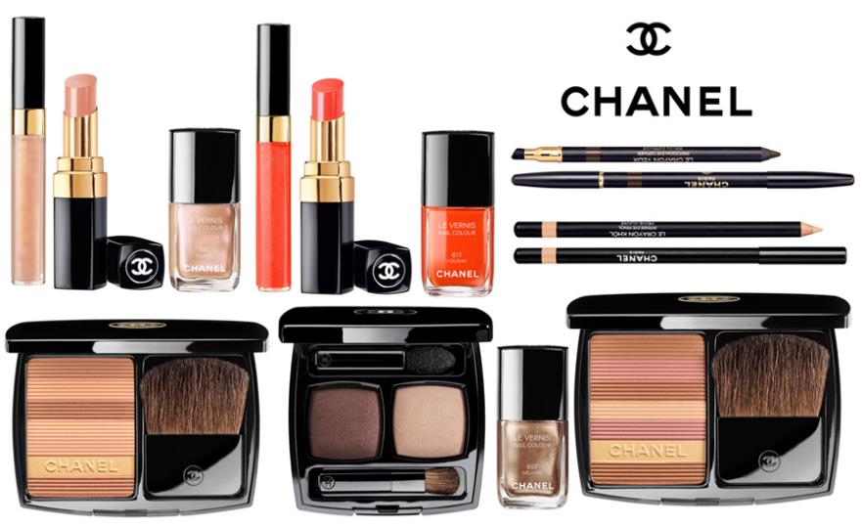

Slide 15
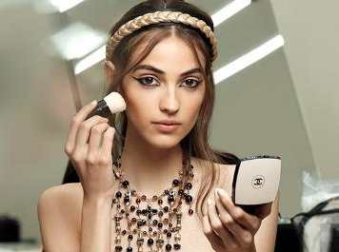
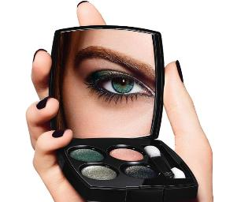
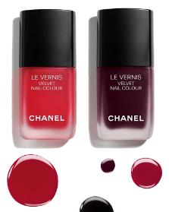
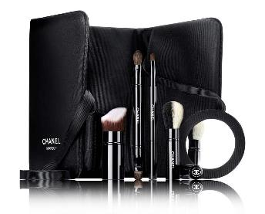
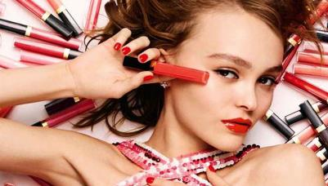

Slide 16
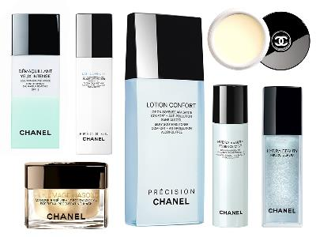
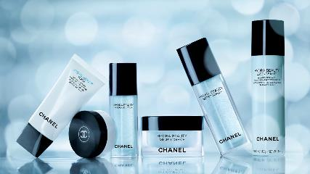
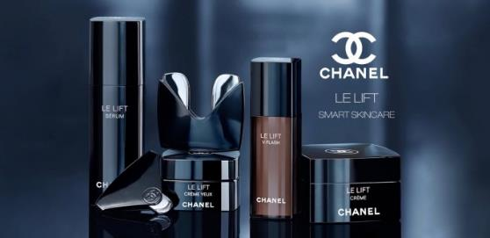
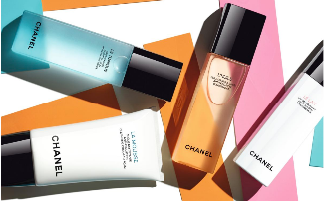

Slide 17
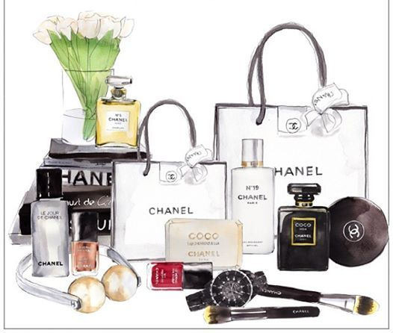
Premium Pricing

Slide 18
Chanel Beauty Products Price Range
Unit
 | Minimum Price | Maximum Price
Make-up Products
Face | $50 | $135
Eyes | $32 | $70
Lip | $38 | $100
Nail colour | $28
Brushes and Accessories | $32 | $60
Skincare Products
Cleansers | $32 | $100
Eyes & Lips care | $50 | $240
Serums | $110 | $650
Moisturizers | $80 | $685
Sun Protection | $55
Body Care | $50 | $230
Masks & Scrubs | $50 | $200
Set
Make-up Set | $92 | $1,500
Skincare Set | $120 | $665

Slide 19
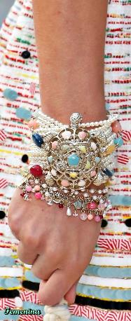
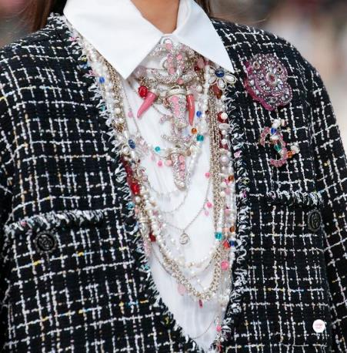
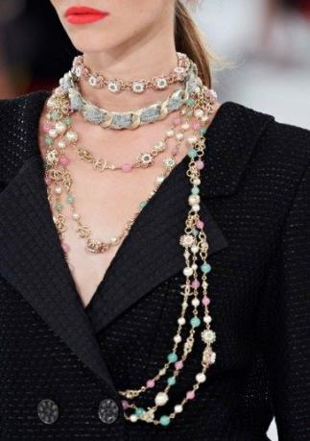
2.3 Jewelry

Slide 20
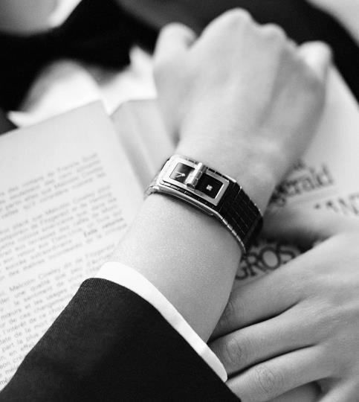
Watches | Types | Minimum Price | Maximum Price
 | J12 | 5 000$ | 20 000$
 | Première | 3 000$ | 8 000$
 | Boy-Friend | 4 000$ | 6 000$
 | Montre Mademoiselle | 4 000$ | 10 000$
 | Code Coco | 6 000$ | 12 000$

Slide 21
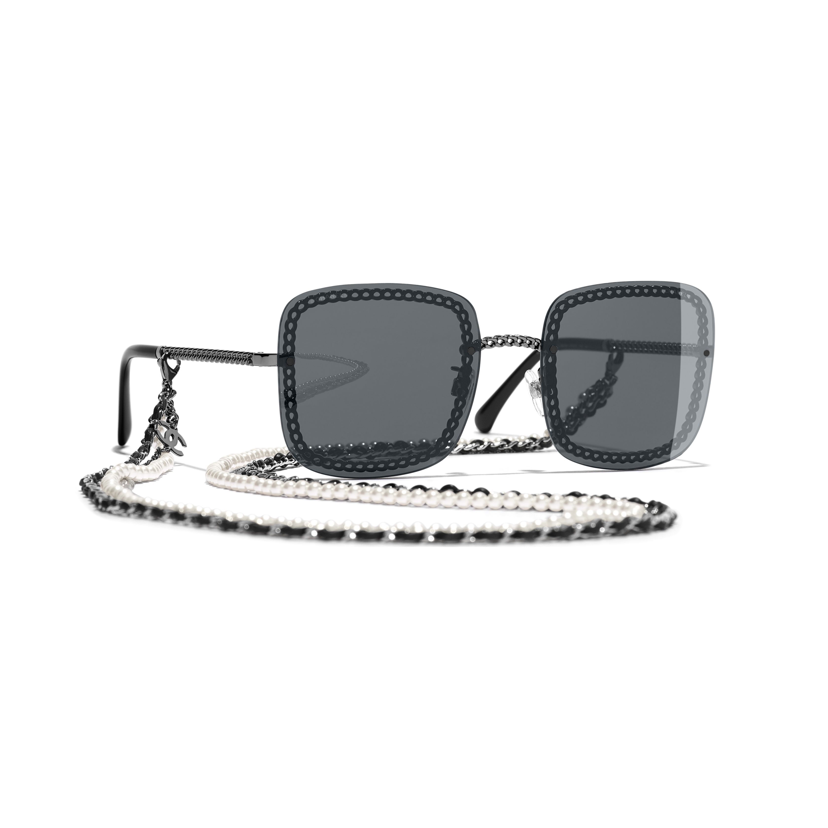
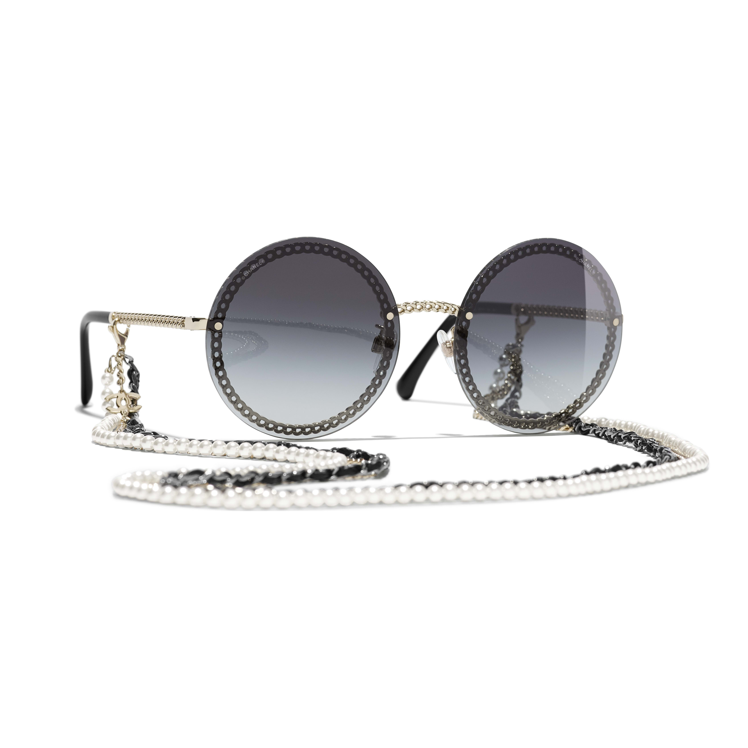
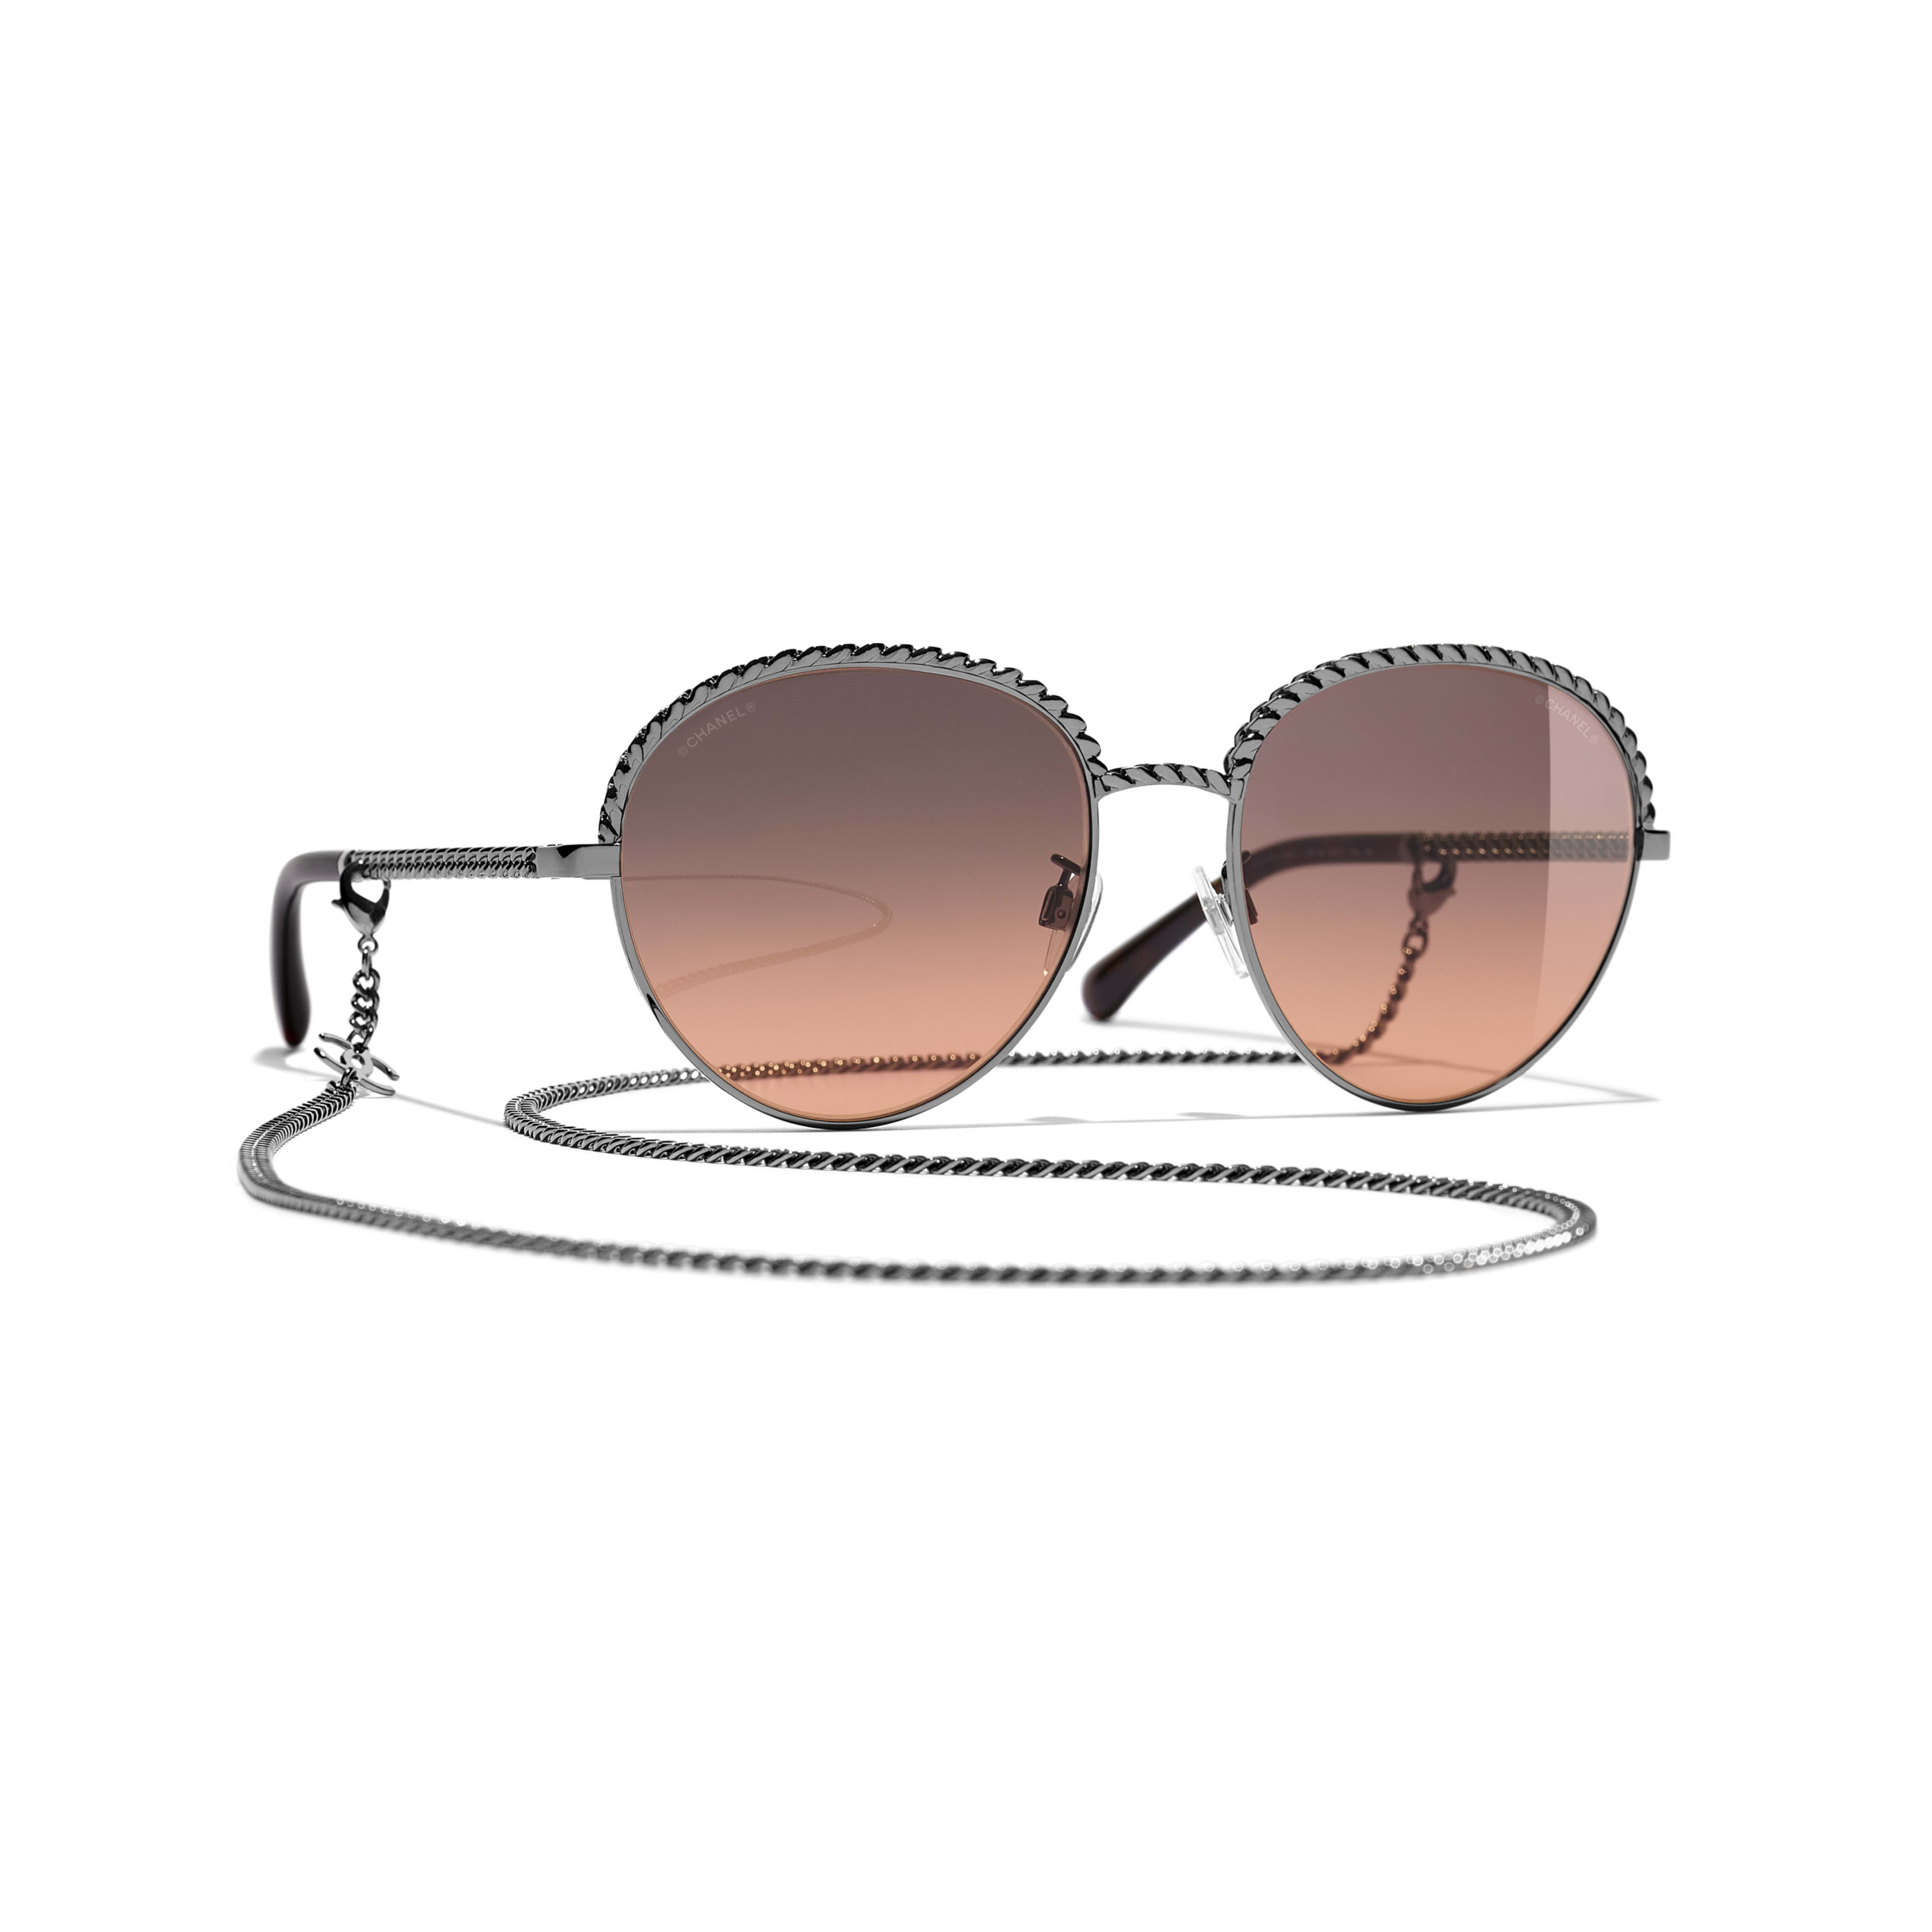
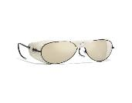





Sunglasses
Square Sunglasses
Round Sunglasses
Pantos sunglasses
Pilot Sunglasses
545$-925$
445$-1250$
550$-750$
365$-975$
Oval Sunglasses
Shield Sunglasses
Butterfly Sunglasses
Clip on Sunglasses
Rectangle Sunglass
500$-1100$
495$-700$
520$
630$
715$

Slide 22


 | Types | Minimum Price | Maximum Price
Fine Jewelry | Rings | 2 300$ | 80 000$
 | Bracelets | 12 000$ | 101 000$
 | Necklaces | 25 000$ | 101 000$
 | Earing | 4 600$ | 16 500$
High Jewelry | Rings | 3 450$ | 6 500$
 | Bracelets | 9 900$ | 50 000$
 | Necklaces | 3 800$ | 10 000$
 | Earing | 4 700$ | 8 600$

Slide 23

2.4 Fashion (Ready-to-Wear)

Slide 24



Premium Pricing

Slide 25
Chanel Fashion Price Range
Fashion |  | Minimum Price | Maximum Price
Ready to wear | Jacket | 13 271 $ | 1 393 $
 | Dress | 8 500 $ | 2000$
 | Top | 5000$ | 1300$
 | Coat | 8 819 $ | 3000$
 | Skirt | 5 443 $ | 1000$
 | Short | 5400$ | 1500$
 | Pants | 3600$ | 1000$
Hand bags |  | 6000$ | 2000$
Scarves |  | 1175$ | 250$
Shoes |  | 1900$ | 700$
Belt |  | 2300$ | 900$

Slide 26



Iconic
Fine Quality
Creative and Unique

Slide 27

2.5 FRAGRANCE

Slide 28

Premium Pricing

Slide 29



WOMEN
Type | Price | Price2
 | Min | Max
Chance | 40$ | 130$
Chance Eau Tendre | 40$ | 138$
Chance Eau Fraîche | 45$ | 75$
Chance Eau Vivre | 45$ | 85$
N°5 | 75$ | 30000$
Gabrielle Chanel | 40$ | 9500$
Coco Mademoiseille | 55$ | 2050$
Coco Noir | 55$ | 210$
Coco | 40$ | 130$
Coco N°19 Poudré | 40$ | 105$
N°19 | 40$ | 130$
Allure | 40$ | 130$
Allure Sensuelle | 80$ | 130$
Cristalle | 85$ | 105$
Cristalle Eau Vert | 85$ | 105$

Slide 30


Men
Type | Price | Price2
 | Min | Max
Bleu de Chanel | 70$ | 177$
Allure Homme Sport | 70$ | 95$
Allure Homme Édition Blance | 95$
ÉGOÏSTE | 75$ | 85$
Platinum égoïste | 75$
Pour Monsieur | 98$
ANTAEUS | 75$

Slide 31

Where it all began…
The cooperation between the Mul family and Chanel
Plants have been grown for fragrances in Grasse for over 300 years
Cooled by the wind and bathed in the Mediterranean sun, the fertile soil of this region provides the ideal conditions for growing high-quality flowers for fragrances
The 20 hectares of fields devoted to flowers for perfume are tended to with unparalleled rigor and care
The Mul family already had an ingrained understanding of the concept “Our flowers are like children who we raise into adulthood”
No chemical fertilisers are used to grow the flowers
The Mul family continues to improve their techniques in keeping with sustainable farming practices, so that the flowers are at their best, and the soil is not depleted
CHANEL and the Mul family share a desire to produce the most fragrant flowers possible and to guarantee the same quality, today and tomorrow

Slide 32



Slide 33






Slide 34

3. Conclusion
The product categories within Chanel have different pricing strategies.
However, it is a premium brand for elite customers.
The quantity of raw materials used for Chanel products is exquisite and rare
The final products are of world class quality and exemplify style and elegance
The target segment is rich and willing to pay

Slide 35

THANK YOU FOR YOUR ATTENTION !!!

